Slide 1
+Center of Elephant and Wildlife Health+ Chiang Mai University, Thailand
Collaborative Strategy for One Health Projects Building: May 23rd , 2023

Slide 2
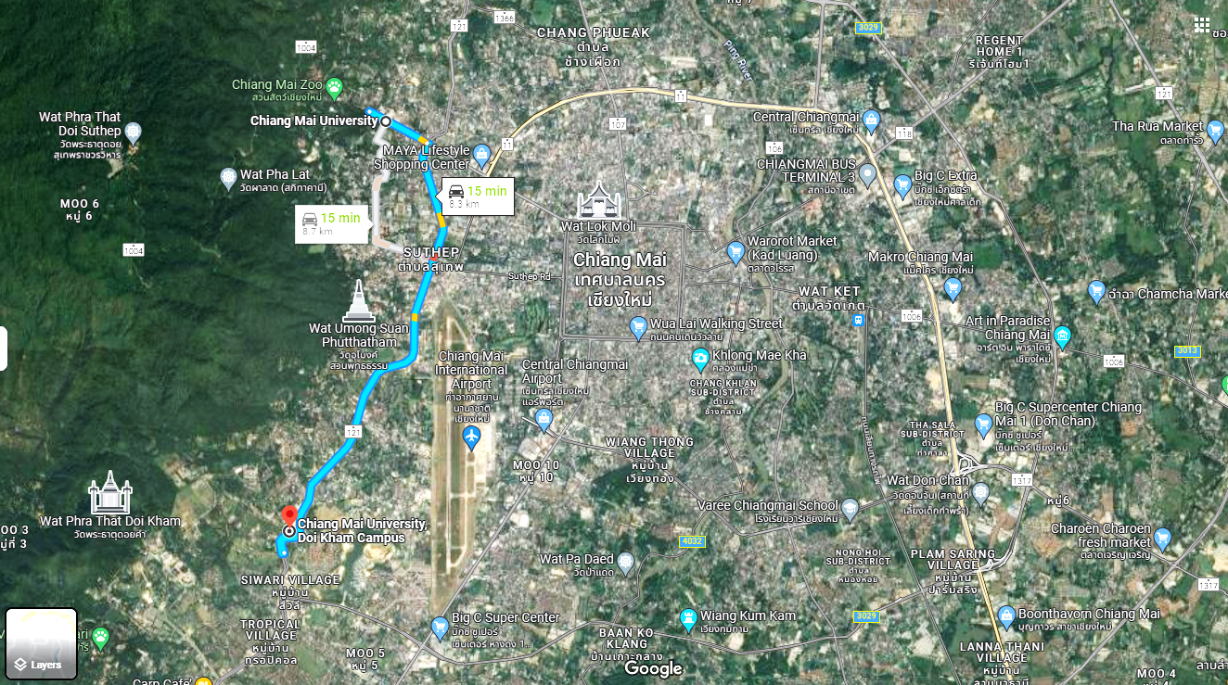
Faculty of Veterinary Medicine
Chiang Mai University
Pornsawan Pongsopawijit, D.V.M., M.S.
Department of Companion Animal and Wildlife Clinics
Center of Elephant and Wildlife Health
Elephant and Wildlife Clinic
Exotic Pet Clinic
Center of Elephant and Wildlife Health

Slide 3
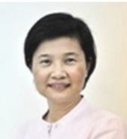
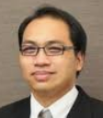
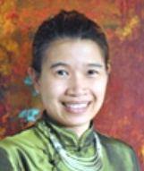
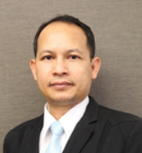
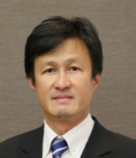
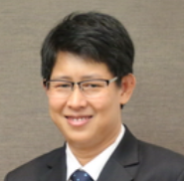
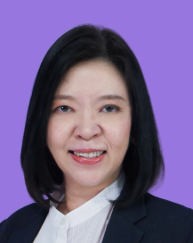
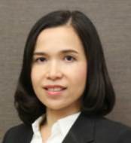
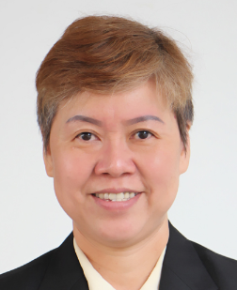
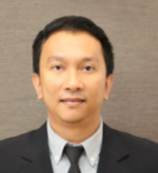
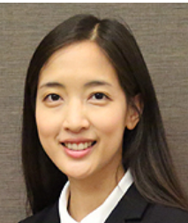
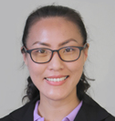
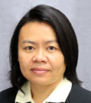
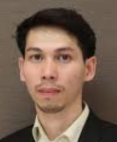
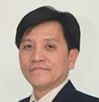
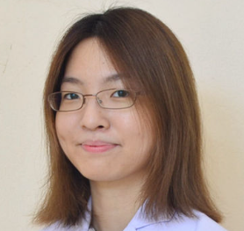
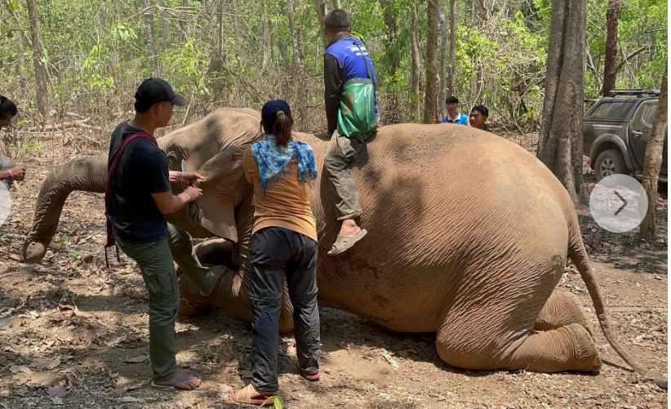
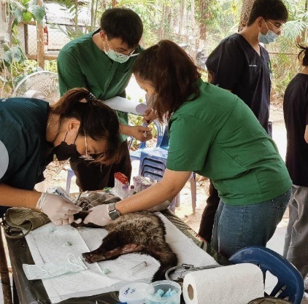
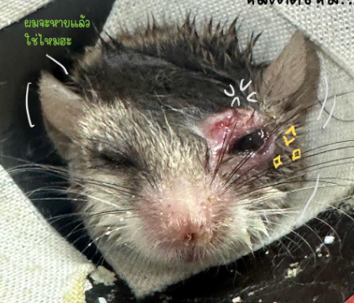
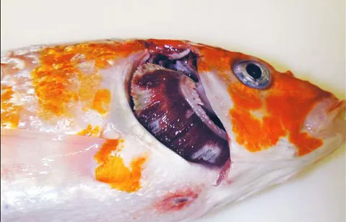
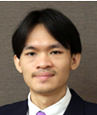
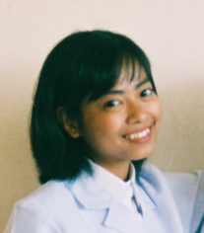
Lecturer/Researcher + Government officer + Laboratory Experts
cv
Chatchote Thitaram, D.V.M.,Ph.D.
Elephant Welfare thitaram.c@cmu.ac.th
Elephant / Wildlife Veterinarian
Preeyanat Vongchan, Med.Tech., Ph.D.
Blood transfusion preeyanat.v@cmu.ac.th
+ National Elephant Institute, Lampang
Chaleamchat Somgird, D.V.M.,Ph.D.
Elephant Welfare chaleamchat.c@cmu.ac.th
+ Department of National Park wildlife and Plant conservation
Siriwadee Chomdej, Biology., Ph.D.
Molecular biology @cmu.ac.th
Kidsadagon Pringproa D.V.M.,Ph.D.
Pathology @cmu.ac.th
Anucha Sirimalaisuwan, D.V.M.Ph.D
Zoonoses @cmu.ac.th
Rattana Sarivongchan, D.V.M. Wildlife Vet HuayHongKrai Royal Development Study Center
Korakot Nganvongpanit D.V.M.,Ph.D.
Anatomy korakot.n@cmu.ac.th
Siriphan Kongsawadi, PT., Ph.D.
Physical Therapist siriphan.k@cmu.ac.th
Supakarn Kaewchote, D.V.M.
DNP PhD student
Jaruwan Khonmee, D.V.M., Ph.D.
Hormone jaruwan.khonmee@cmu.ac.th
+ Department of Livestock Development
Chatchanok Udomtanakunchai , RT., Ph.D.
Radiologist @cmu.ac.th
Surachai Pikulkaew, D.V.M., Ph.D.
Aquatic Surachai.pikul@cmu.ac.th
Nantanee Satiansukpong, OT., Ph.D.
Occupational therapist @cmu.ac.th
Ph.D. Student
Pakkanut Bannasith, D.V.M., Ph.D.
Elephant Welfare pakkanut.b@cmu.ac.th
Chidchamai Kewcharoenwong, MT., Ph.D.
Rabies Titer chidchamai.k@cmu.ac.th
Yaoprapa Mathura, D.V.M.,M.S.
Aquatic / Zoo Ph.D. student yaoprapam@gmail.com
Pornsawan Pongsopawijit, D.V.M., M.S.
Veterinarian pornsawan.p@cmu.ac.th
Worapong Kosaruk, D.V.M.,M.S.
Elephant Ph.D. Student woraph.kosa@gmail.com
Human / Environment
Clinical Veterinarian
Sarisa Klinhom, D.V.M.,M.S.
Elephant Ph.D. Student
Suwat Chariyalertsak, MD., Ph.D.
M. tuberculosis
Nicharee Luevitoonvechakij, D.V.M.
Exotic Pet Clinic nicharee.l@cmu.ac.th
Chitchol Phalaraksh
(Limnology, Freshwater Ecology)
Pichamon Ueangpaibool, D.V.M., M.S.
Elephant Clinic pichamoneye@gmail.com
Khathawat Phatwan, D.V.M.
Aquatic Veterinarian
Pavinee Kulnanan, D.V.M.
Veterinarian pawinee.vetmed@gmail.com
Elephant Mobile Clinic
Donation-NGO Funding
Wildlife Clinic
Government
Exotic Pet Clinic
Owner
Aquatic Clinic
Owner

Slide 4
What knowledge gaps would you like to address?
2008 Reproductive Biology: Elephant Breeding
2009 Reproduction: Elephant Reproduction
2010 Genetics: Elephant Population
2013 Pathology: Elephant Endotheliotropic Herpes Virus
2015 Blood Transfusion: Elephant Frozen Plasma
2016 Forensics: Elephant Task
2017 Physical Therapy: Elephant Biomechanics
2019 Endocrinology Lab: Elephant Welfare Management
2020-2022 COVID-19 Elephant Tourism
2023 One Health – Animal / Plant / Environment / Human
Notes:
Veterinary team from Chiang Mai University
Thai Elephant Alliance

Slide 5
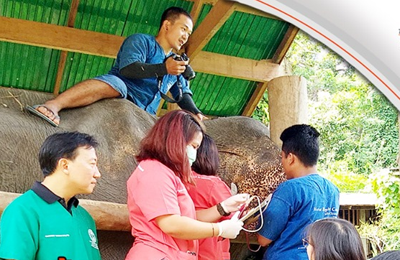
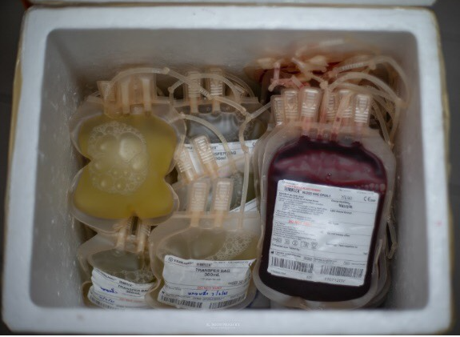
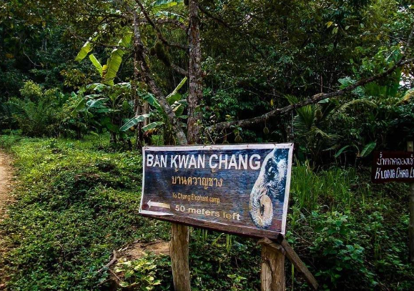
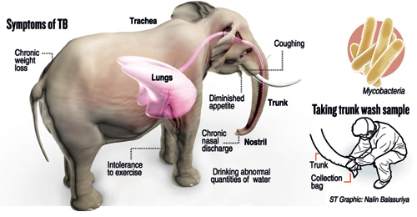
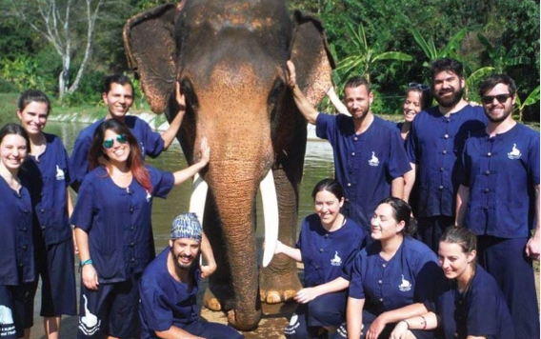
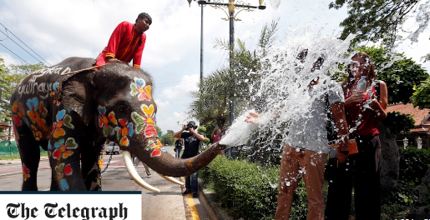
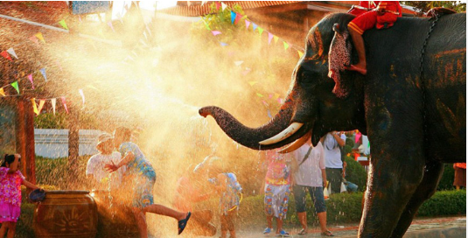
Elephant camp model: Welfare and one health approach
ELEPHANT HEALTH
Elephant reproduction and genetics
TRAINING
Elephant healthcare management
(Elephant tourism potentialities and knowledge enhancement for elephant tourist staffs)
Elephant breeding management
Elephant genetics
https://www.asianelephantresearch.com/research/
Elephant Endotheliotropic Herpes Virus (EEHV)
fresh-frozen plasma
ELEPHANT WELFARE
Elephant in Thai culture
DISEASE CONTROL/PREVENTION

Slide 6
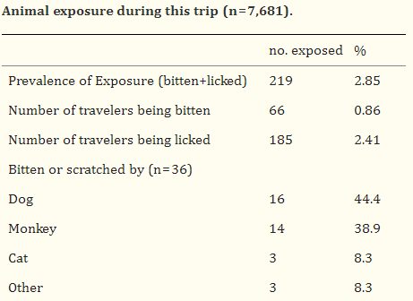
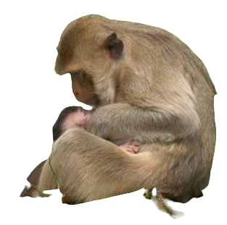
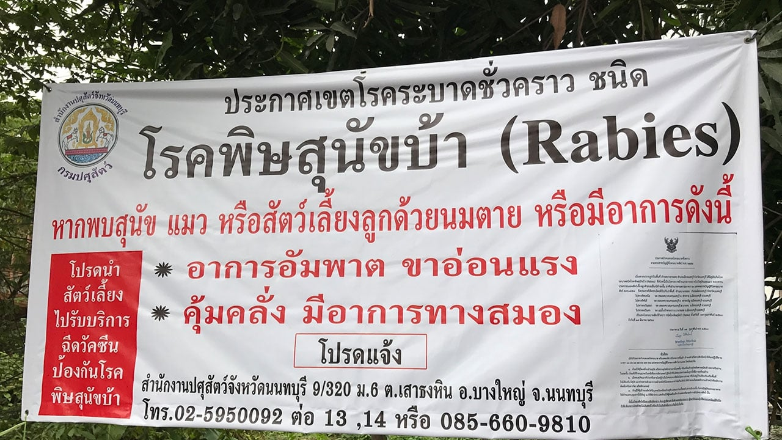
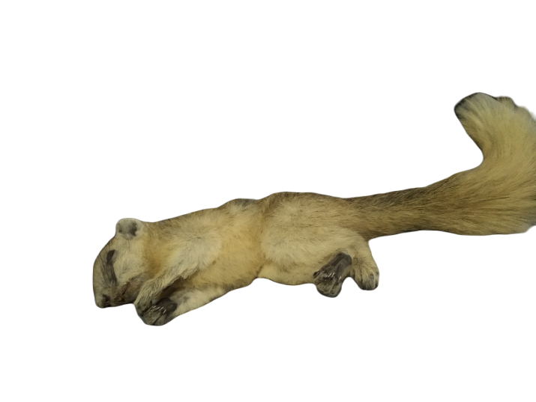
How would I like to improve my activities?
Types of research
Clinical Research - Publication
What research questions do you want to address?
Rabies Status , Risk Assessment and Management of Exotic and Wild animals in Chiang Mai
Captive Macaque
Rabies Risk Communication
Piyaphanee et al., 2012
Dead Wild squirrel

Slide 7
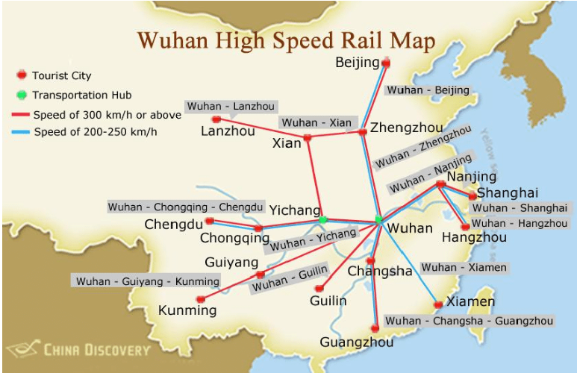
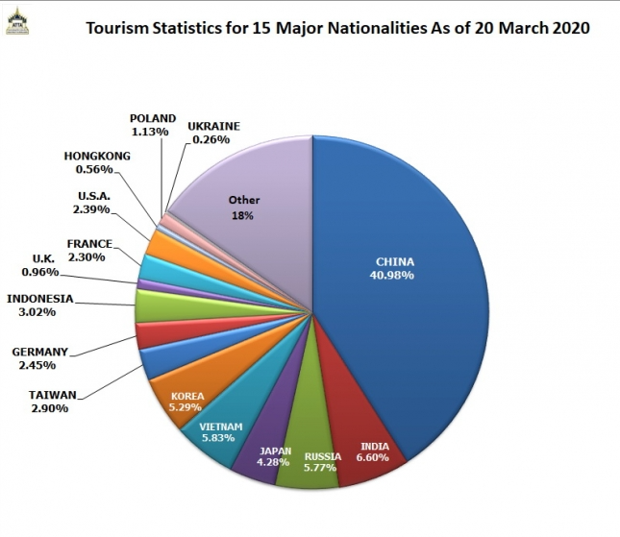
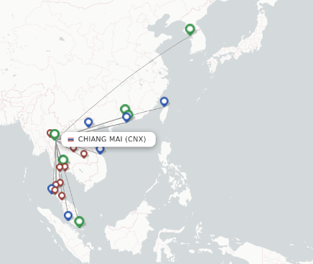
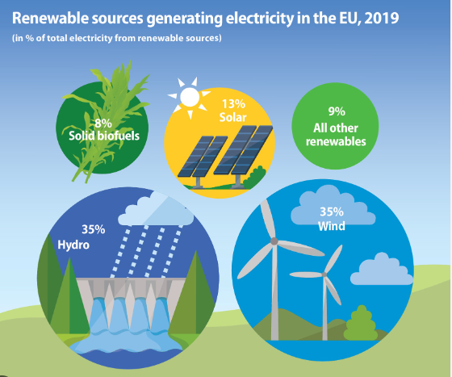
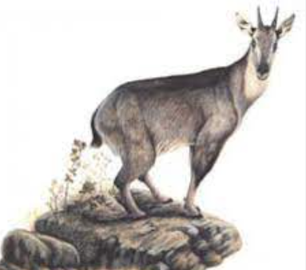
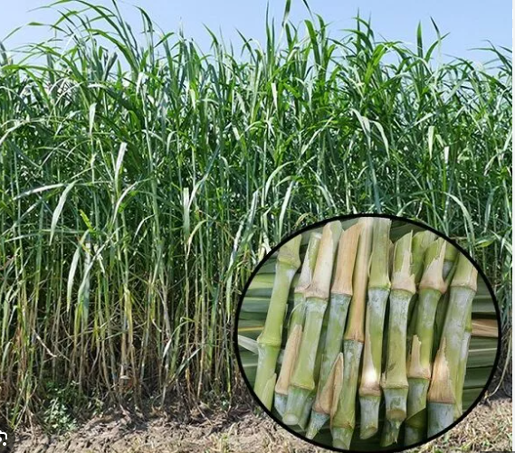
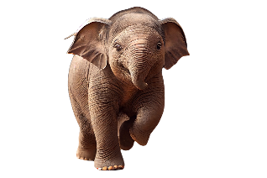
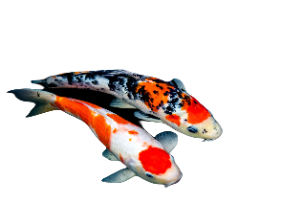
One Health
Logistic
Chiang Mai
CMU
Animal
?
Pigs
Wild rodent
JE in Macaque
Plant
Herpes in Elephant
TB
Goral
?
Herpes in Koi

Slide 8
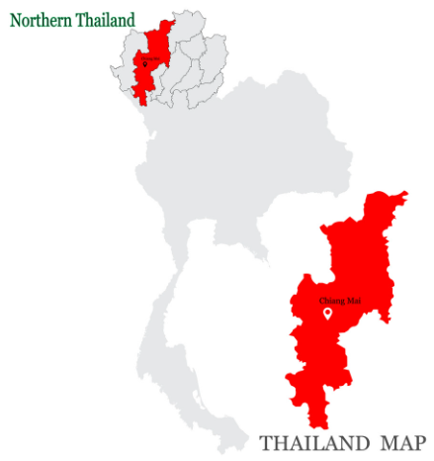
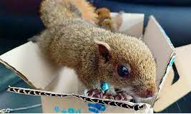
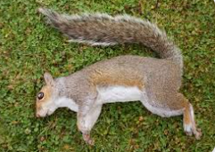
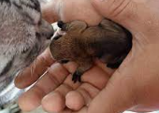
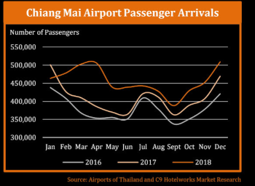
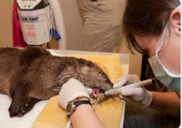
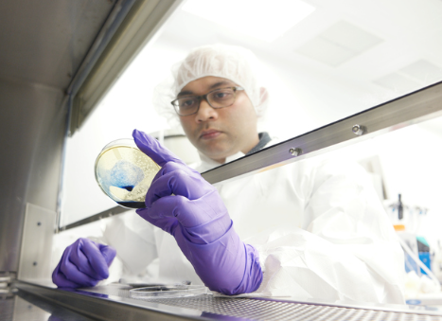
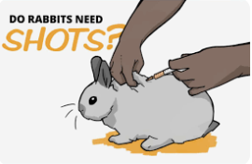
Research Question
Airport of Thailand
C9 Hotel work market Research
rapid simple techniques for collection of brain samples (brainstem with medulla oblongata) in animals (dog) via the occipital foramen in field settings
Mauti et al., 2020
Direct fluorescent antibody
Notes:
Chiang Mai is the high population of tourist. And it’s important to control the zoonotic diseases from animal.
Exotic small mammals that living with the owners and Wild small mammals tourism in Chiang Mai city
Veterinarians, Vet students, Laboratory technicians will have the high risk to contact zoonoses
Health care professionals who have to handle the suspected animals haven’t train to identify risk in exotics/ wild mammals, and recommend the preventive programs in Exotic mammals. and finally the appropriated sampling from dead carcasses.
Tourist who visit Thailand Piyaphanee et al., 2012 report that travelers were at risk of being exposed to potentially rabid animals while traveling in Southeast. Asia. reported 1% of 980 travellers was injured by a potentially rabid animals. (Croughs et al., 2021)
The zoonotic agents that have been reported in Northern Region
Rabies, Streptococcus suis, Trichinellosis

Slide 9
What is the most important question you would like to address in one health research proposal?
Migrant worker + Tourism
International Resident + Children
Exotic pet owner + Zoonotic Risk Behavior
Pathogens + Risk Behavior
Disease Prevention / Transmission -> Innovation?
Direct contact, Lick? Bite? -> Biosafety / Disease Vaccination
Fecal-Oral Route -> Food Safety / Food Hygiene
Airborne -> Mask / Air Purifier
Vectors Born -> Insect Control

Slide 10
Logistic – High Speed Train
Ministry of Commerce

Slide 11
How would you like to contribute to a research proposal ?
Training the professional healthcare professionals to find the risk of zoonotic diseases and prevent risk of expose zoonotic materials.
to improve overall prevention of zoonotic disease at the diagnostic lab
to develop in-house training programs for professional healthcare to prove it’s value to the overall medical and management programs and provide diagnostic support for clinical cases with timely and complete necropsy.
to provide necessary data to support basic and applied research with subsequent publications in peer reviewed journals.

Slide 12
Questions & Answers
7 core competency
7 technical module

Slide 13
Thai-Lao Border Market
Local market ตลาดนัดจุดผ่อนปรน ไทย-ลาว
Raw shrimp
Exotic Food: Reptile
Economic Area : Market
Bushmeat
Rodent Eating

